Slide 1
OHIO PHARMACISTS ASSOCIATION
Independent Special Interest Group (ISIG)
First Meeting of the 2026-2027 SIG Year
Thursday, September 3, 2026 | 12- 2:00 PM | Microsoft Teams
Co-Chairs: Andrea Kowalski and Sangita Patel | Staff Liaison: Myriam Shaw Ojeda
Notes:
Sangita

Slide 2
Introductions
Let's go around the room - about 45 seconds each
Tell us three things:
1. Your name and where you practice
2. Your organization and location
3. What is your favorite Ohio-based activity? (OSU football, apple picking, boating etc.)
Notes:
Sangita

Slide 3
Agenda
Thursday, September 3, 2026 | 12 - 2:00 PM
Welcome & Call to Order
Introductions & Roll Call
ISIG Goals
Staff Reports
Open Discussion
Programming and Upcoming Meeting Dates
Adjournment
Notes:
Sangita

Slide 4
Antitrust Avoidance Statement
“I have been asked to remind all of you in attendance that various state and federal laws prohibit the exchange of information among competitors regarding matters pertaining to price, refusals to deal, market division, tying relationships and other topics which might infringe upon antitrust regulations, and that no such exchange or discussion will be tolerated during this meeting.
These guidelines apply not only to the formal meeting sessions, but to informal discussions during breaks, meals or social gatherings.
Thank you for your cooperation.”
Also on the agenda: No new minutes to approve
Notes:
Andrea

Slide 5
ISIG Goal
Co-chairs
Notes:
Andrea

Slide 6
ISIG Purpose
PURPOSE
This SIG supports pharmacists and technicians in the field of independent pharmacy by providing a platform to discuss best practices, challenges, regulatory considerations, and advancements in the field.
Notes:
Andrea

Slide 7
CEO Update
Sara Kilpatrick, CEO
Notes:
Sara

Slide 8
Pharmacist Dispensing of Nicotine Cessation
Products & Oral Contraceptives
Draft bill language — not yet introduced
▪ OPA has drafted bill language allowing pharmacists to dispense nicotine cessation products and oral contraceptives
▪ The draft has been shared with partners at Upstream and the Ohio Board of Pharmacy for feedback
– It has not been introduced — this is your chance to shape it before it is
▪ Reading the draft: strikethroughs are language that would be removed from the Ohio Revised Code; underlined portions would be new law
▪ The PDF will be shared in the meeting chat for review after today
What we need from you: does this language work in your practice setting? What is missing, unclear, or operationally difficult?
Notes:
Sara

Slide 9
Staff Report and RHTP Grant Introduction
Myriam Shaw Ojeda, Staff Liaison
Notes:
Andrea

Slide 10

OPA
RURAL HEALTH TRANSFORMATION PHARMACY INITIATIVE
An Overview

Slide 11

OVERVIEW
  History of RHTP
  Ohio Proposal
  OPA Workplan
  How to get involved?

Slide 12
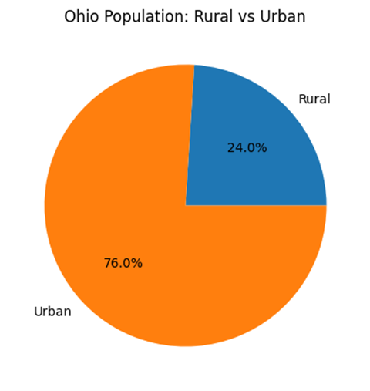
Ohio’s Rural Population
  Ohio has one of the largest rural populations in the Midwest.
  Rural residents are generally older and experience higher rates of heart disease, diabetes, obesity, smoking, and COPD.
  Rural communities have fewer primary care providers, dentists, and mental health professionals.

Slide 13

Authorized by the One Big Beautiful Bill Act (Section 71401 of Public Law 119-21)
What is the
Rural Health Transformation
(RHT)
Program?
Federally supported initiative designed to strengthen healthcare delivery in rural communities across the US
Focuses on improving access, quality, sustainability, and coordination of care

Slide 14

Why is Pharmacy Central to RHT
•CMS requested a pharmacy call out in each state’s plan for RHT
•Cicero Institute Report*
•ODH’s proposal included pharmacy
*In the Cicero Institute’s 2025 pharmacist full practice authority scoring, Ohio scored 1 out of 10, placing it near the bottom nationally.

Slide 15
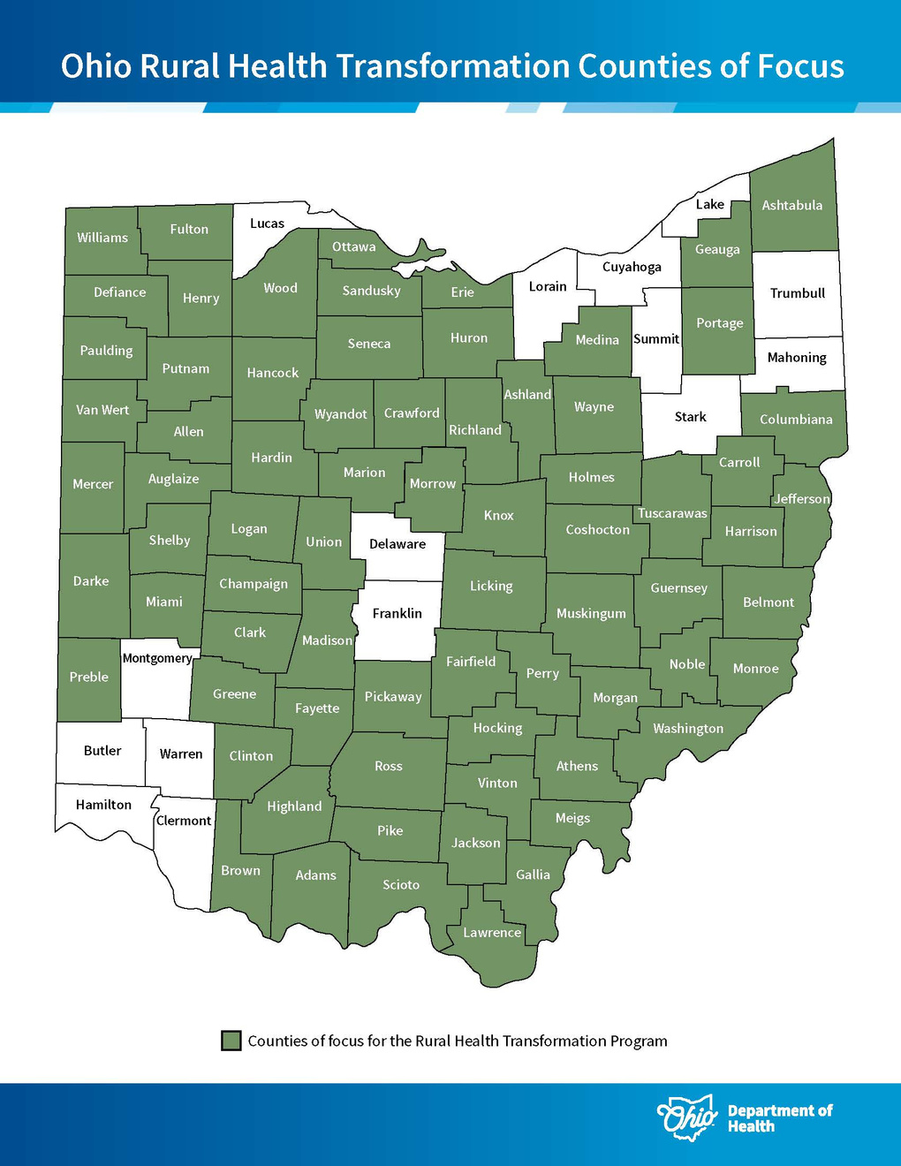
Ohio’s RHTP Proposal
  Ohio submitted a statewide Rural Health Transformation application through the Ohio Department of Health.
  ODH was awarded approximately $202 million for FY2026, with the opportunity for additional annual funding through 2030 based on progress and outcomes.

Slide 16
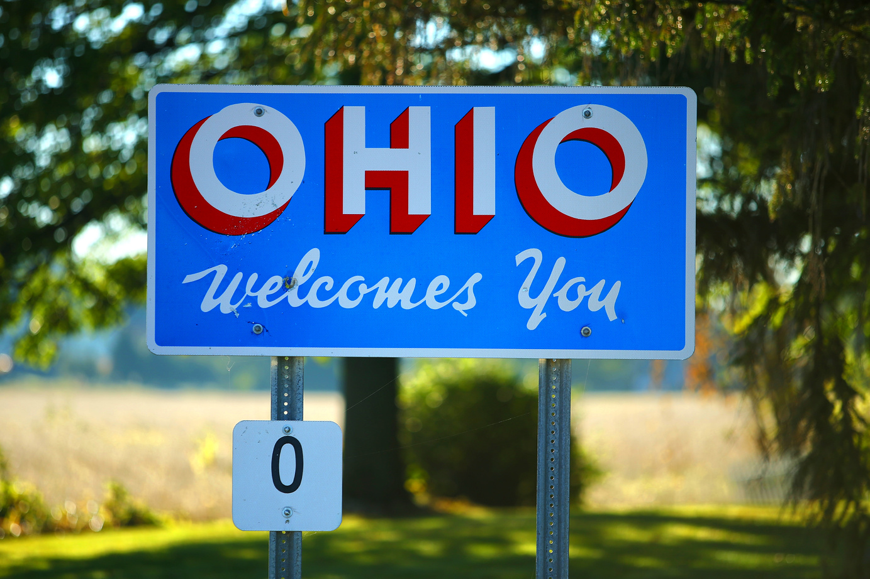
Ohio’s RHTP Pharmacy Plan
Core Vision
Build a statewide rural pharmacy network that:
  Connects pharmacies to CliniSync (HIE)
  Expands pharmacist-led clinical services
  Integrates pharmacies into the broader healthcare system
End Goal to Improve
Patient Outcomes
Medication Safety
Access to Care
System Efficiency

Slide 17
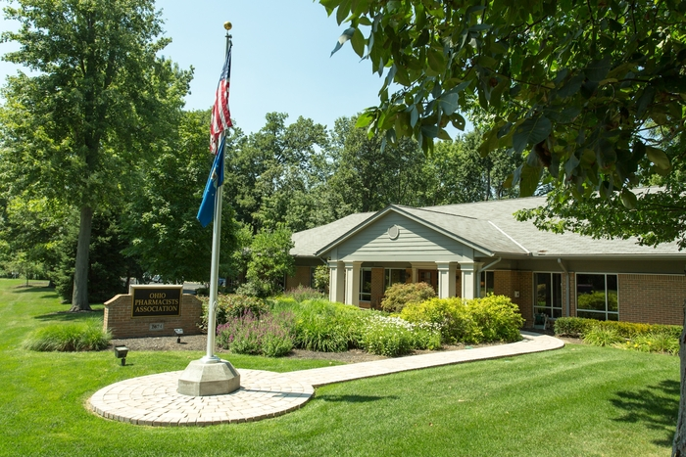
OPA’S PROGRAM MODEL
1
Needs Assessment
$2 Million
Year 1
2
Connect pharmacies to HIE
3
Train pharmacy workforce
4
Launch clinical services
$2 Million
x2 more
2-year terms
5
Evaluate outcomes
6
Scale statewide

Slide 18
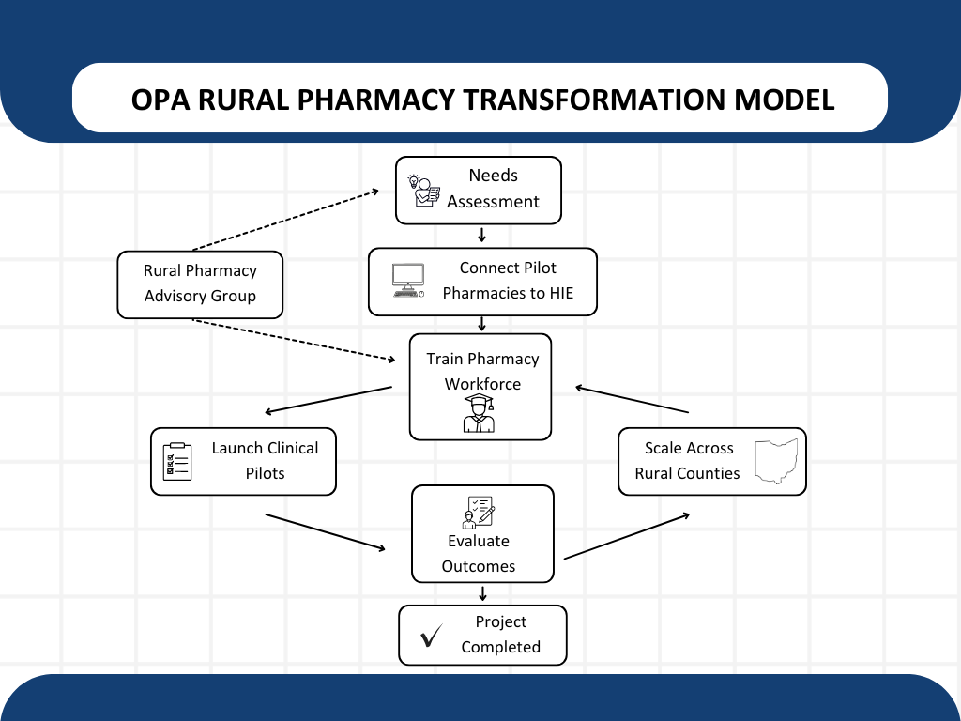

Slide 19
OPA Work Plan
01
02
03
Needs Assessment
Rural Pharmacy Advisory Group
HIE Integration
Goal: Advise OPA on needs assessment and pilot sites
(Pharmacists, Health system leadership, FQHCs, Payors, Patients, and more......)
  Connect to CliniSync
  Meet hardware and software needs
  Workflow support
  Integration
  Pharmacy incentives
  Statewide survey to 73 counties
  Staffing capabilities
  Technical capabilities
  Training needs

Slide 20

Pilot Pharmacies
  Independent
  Small chain retail
  Large chain retail
  FQHC
  Hospital Outpatient

Slide 21
OPA Work Plan
04
05
06
Technical Training
Clinical Services
Scale
  Workflow integration
  Troubleshooting patient file access
  Pull the first patient file
  Chronic disease management
  Remote patient monitoring
  Point-of-care test and treat
  Medication safety interventions
  Expand to 73 counties
  Outcome reports at local to national platforms
  Continuous quality improvement (including integration)

Slide 22

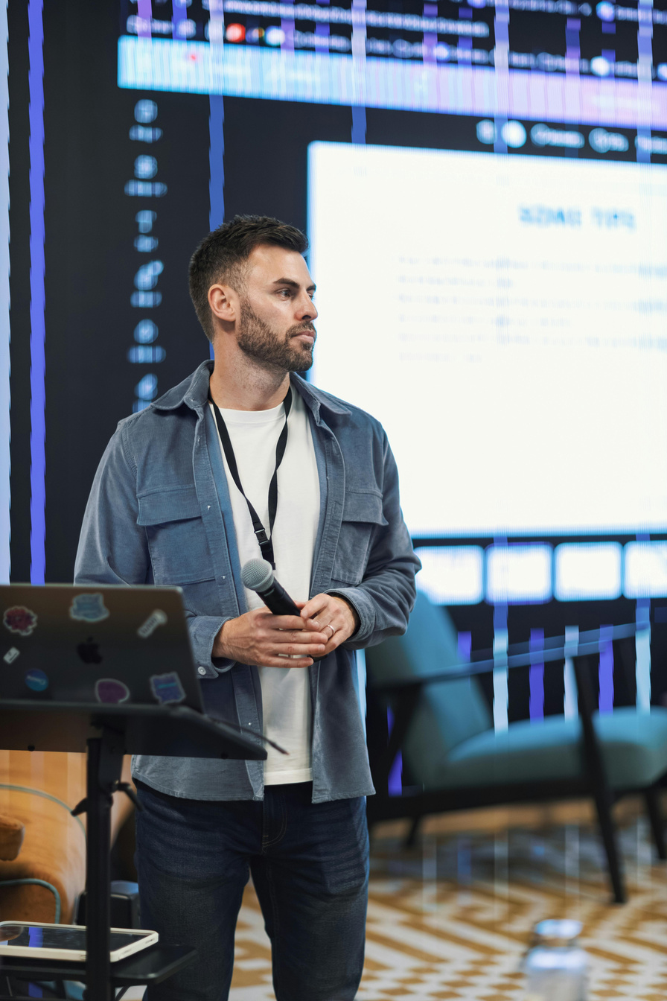

What is Next?
Leadership
Subject Matter Expert
Member Involvement
Pilot Site
  Forming advisory committee
  Leaders who supervise potential sites
  Experience in specific community sites
  Clinical know how
  Workflow know how
  Billing know how
  PAI Committee: Training
  Leg and Reg Committee: Advocacy
  Communications Committee: PR
  ISIG: Pilot sites
  Others....
  Fill out needs assessment
  Consider staffing capabilities
  Plan for Fall 2026
Fall 2026
Fall 2026
Summer 2027
Fall 2026

Slide 23
OPA Advocacy
SB 230
UPCOMING
AND MORE
Point-of-care Test and Treat
Nicotine and Birth Control
Practice Advancement
  Allows pharmacists to test and treat for
    Flu
    COVID-19
    Strep
  Protocol-based
  Dispensing and counseling
  Standard of Care
  Remote Physiologic Monitoring
  HIV PEP and PrEP
  And more......

Slide 24
Additional RHTP Funding
  Educational Support to upskill pharmacists, technicians, and students
    Remote Physiologic Monitoring
    Test and Treat
    And more......

Slide 25
How Can I Get Involved?
  Respond to the Needs Assessment
  Participate in the program
  Subject matter experts participate in CE development
    Test and treat
    Remote patient monitoring
    Chronic disease management

Slide 26
We are hiring!
  OPA Fellow
  Program Manager
  See OPA website for more information!

Slide 28
THANK YOU!
Questions? mshawojeda@ohiopharmacists.org

Slide 29
RHTP Grant — What It Means for the ISIG
TODAY
▪ Introduction to the grant and its scope (15 min)
▪ How the work is structured and who is involved
▪ Questions from the committee (5 min)
WHAT IT MEANS FOR THIS COMMITTEE
▪ Consider if your site could serve as a pilot location
Respond to the needs assessment when it is released
▪ Opportunities for members to contribute directly — more detail to follow
Notes:
Myriam

Slide 30
Challenges and Opportunities
Co-chairs
EQuIPP
Fall Vaccines (COVID-19, Influenza, RSV, etc.)
NCPA Access Program
Others?
Notes:
Sangita

Slide 31
Open Discussion
Co-chairs
A time to share wins, new projects, and advancements in your practice site.
Notes:
Andrea

Slide 32
OPA Innovation Summit:
Midyear Reimagined
November 6, 2026 · Registration is now live
Notes:
Myriam

Slide 33
Midyear Session Lineup
Remote Physiologic Monitoring (RPM) & Artificial Intelligence (AI)
Specialty Medications
Across Practice Settings
Social Determinants
of Health
Clinical Guideline Updates Pearls from recent changes
Jennifer Sabatino
Ariel Williams
Andrew Faiella
4 speakers · 15 min each
▪ Registration is live
Notes:
Myriam

Slide 34
Programming & Announcements
Seminar
Pharmacy Technician Education Seminar
September 18, 2026
Held at the OPA office
Registration closes September 15
Awards
2027 Award Nominations
Nominate a colleague for an OPA Award - Bowl of Hygiea, Public Relations, Good Government, Distinguished Young Pharmacist, Generation Rx, or UNDER 40. Introducing the Technician of the Year Award.
Due by September 15, 2026
Summit
OPA Innovation Summit
Midyear Reimagined
November 6, 2026
Registration open.
Notes:
Myriam

Slide 35
Upcoming Meeting Dates
All meetings are virtual, 12 - 2:00 PM · Calendar invitations have been sent
Thursday
Thursday
Thursday
November 3, 2026
January 14, 2027
March 4, 2027
Off-cycle subcommittee and workgroup meetings will be scheduled as needed.
Notes:
Sangita

Slide 36
Thank you!
Looking forward to a great year together.
Next meeting: Thursday, November 12, 2026 · Noon · Microsoft Teams
Andrea, Sangita, & Myriam
Notes:
Andrea

